Slide 1
SCT 09/15/22
Gabriel Brooks
NOAA NMFS NFSC
Fish Ecology Division
206.526.6704
Gabriel.Brooks@NOAA.gov
Sep 15, 2022

Slide 4
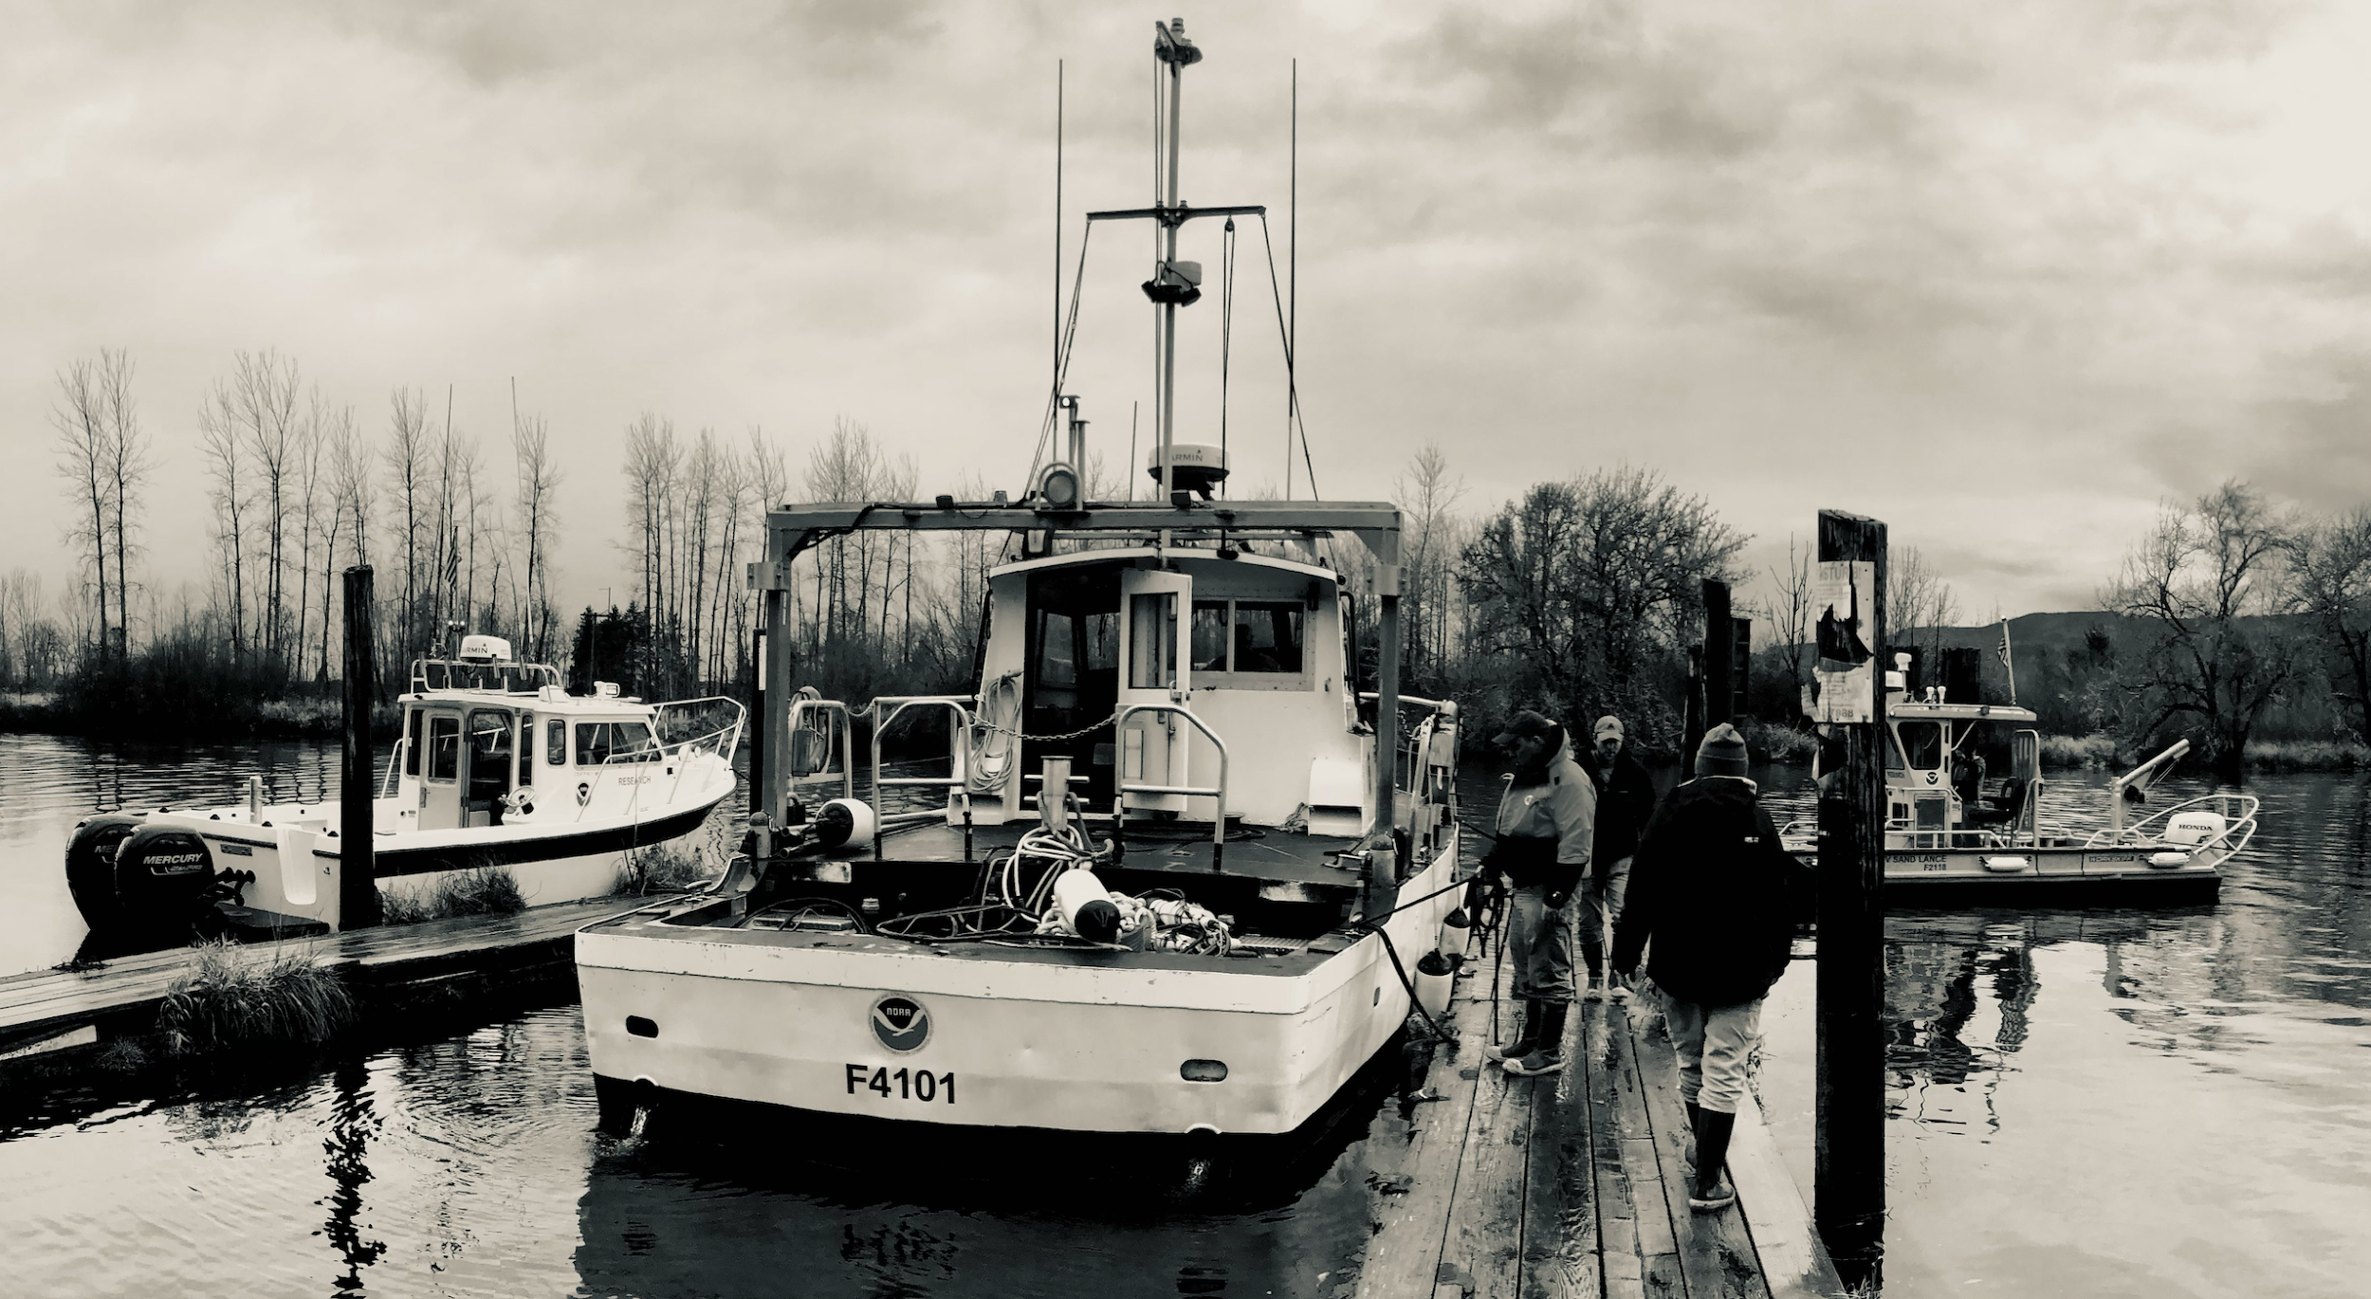
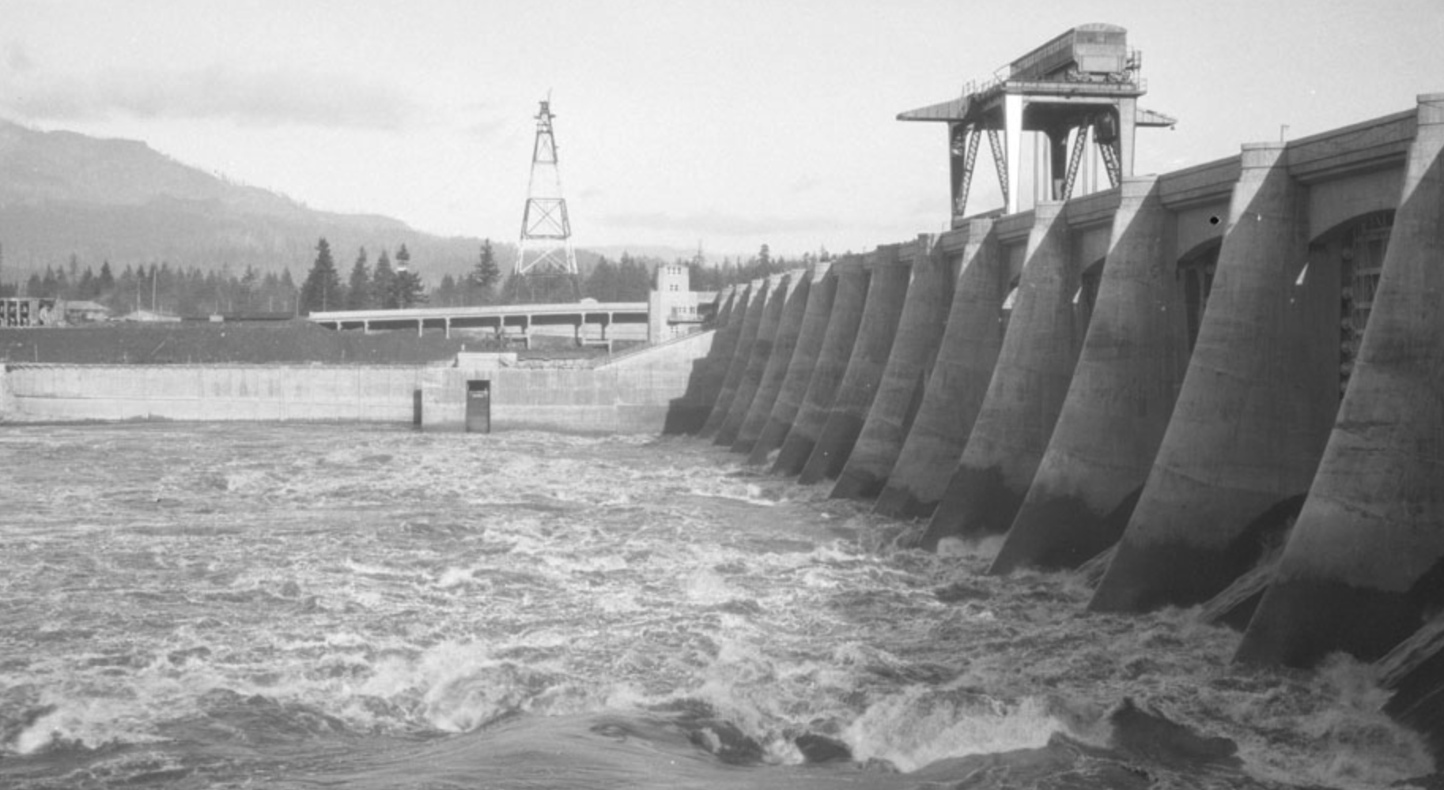
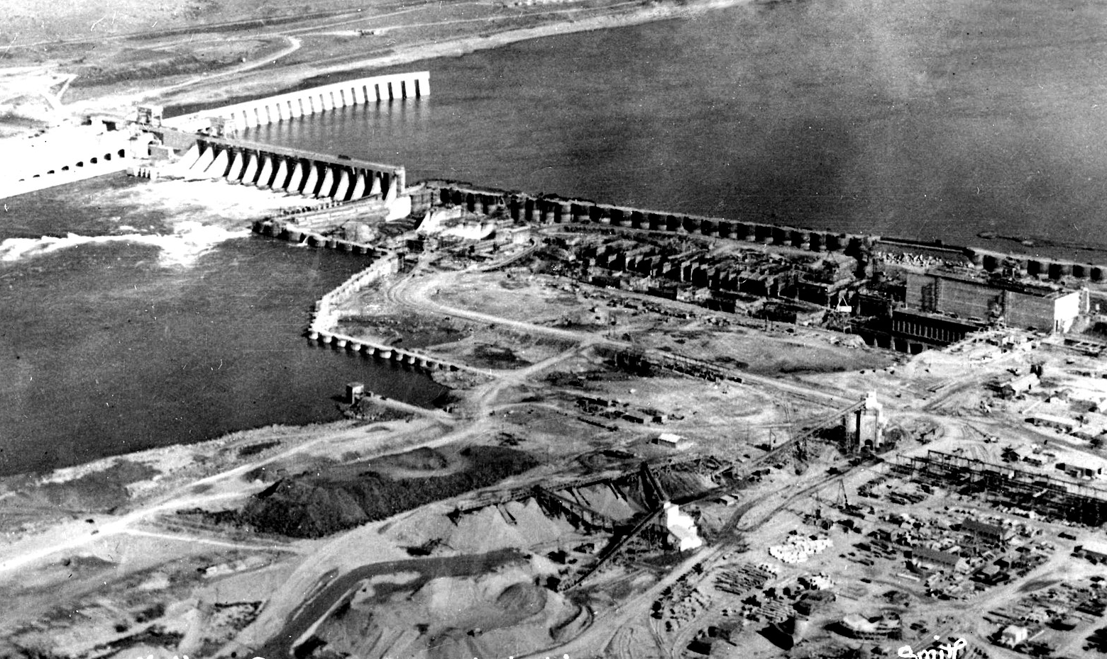
Improving PIT detections
Post Bonneville (Estuary)
TWX
Pile Dikes
FACA (Flexible Antenna Cable Array)
Bonneville
2019 EDR
ITS moveable and fixed gates
McNary
JBS outfall antennas
TSW cap antennas
TSW fin antenna
TSW floating antennas

Slide 5
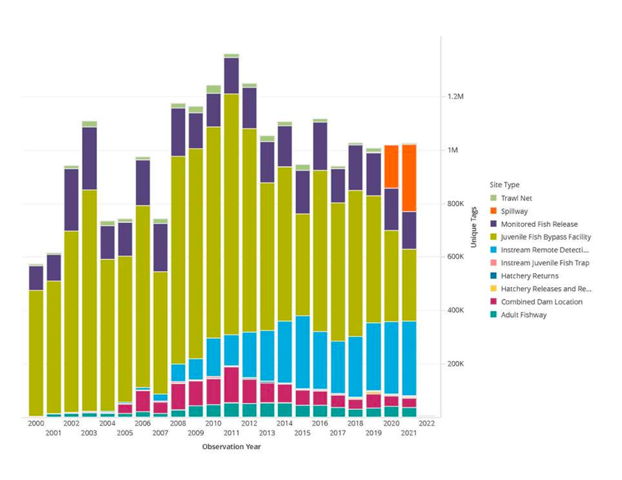
CRB PIT detection

Slide 6
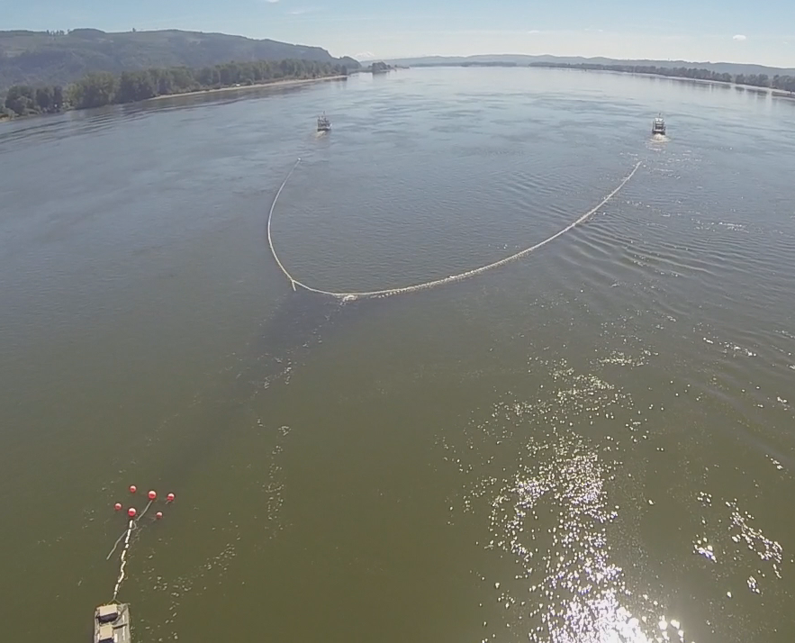
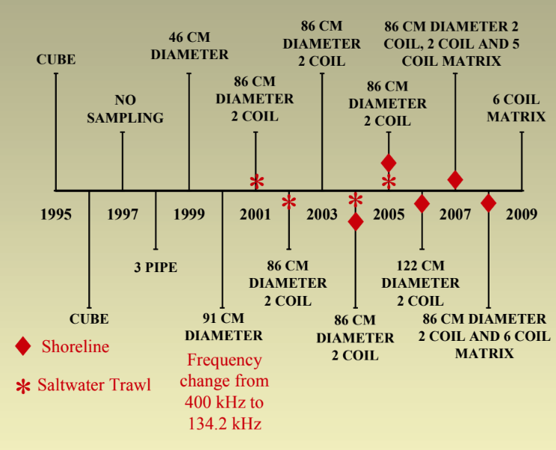
Pair Trawl or TWX from 1995 - 2022
The TWX system has historically been the primary means for post-Bonneville detections

Slide 7
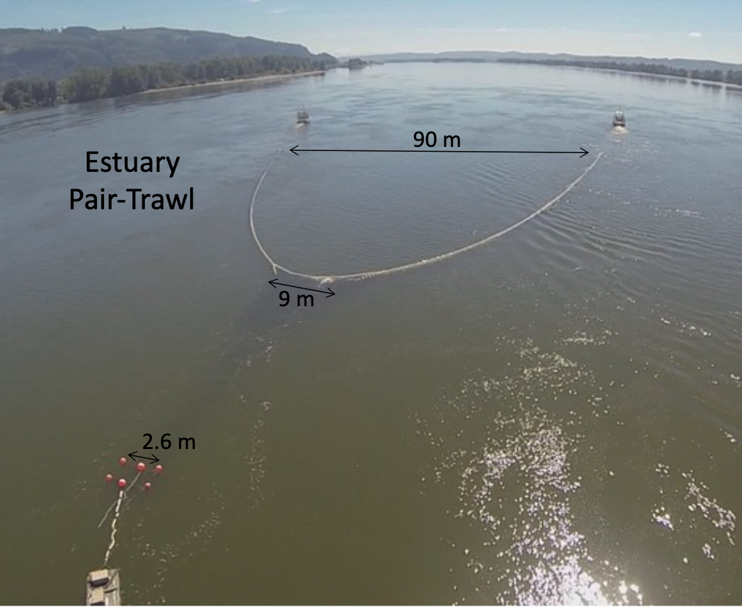
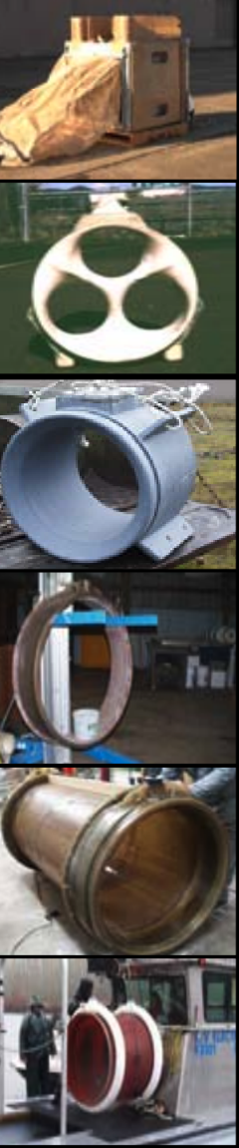
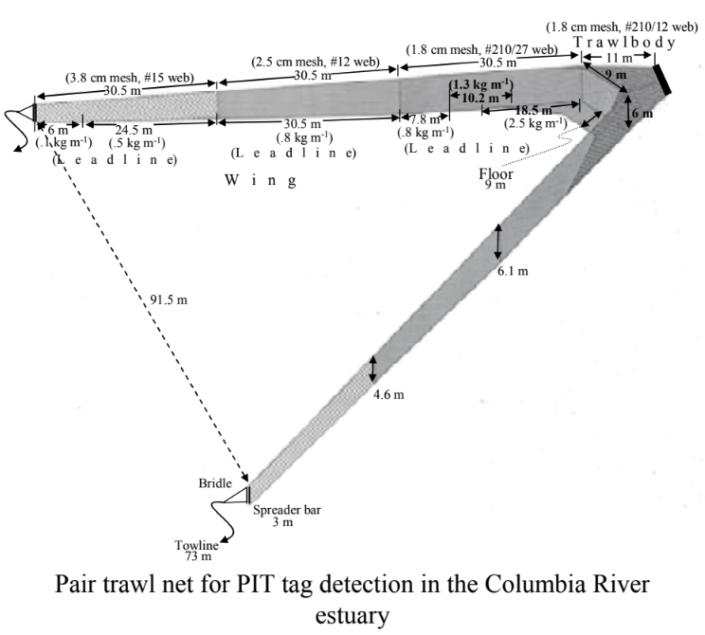
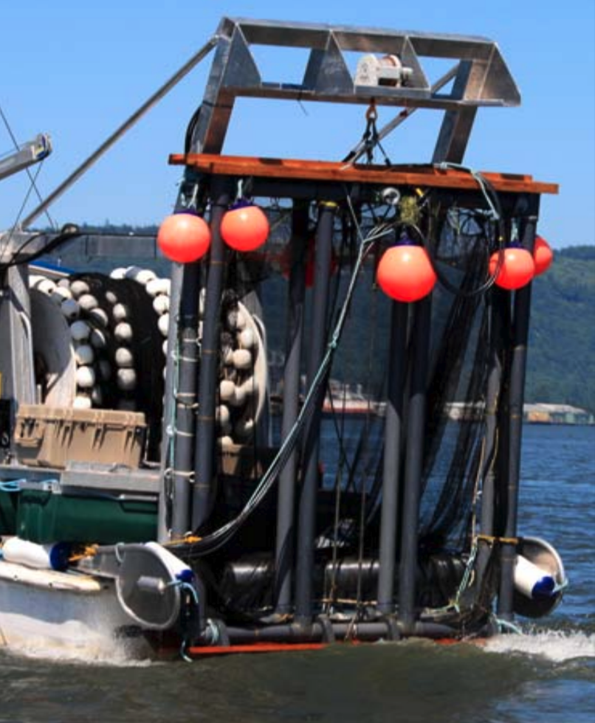
Pair Trawl (TWX)
The trawl has evolved over time, but has been essentially the same since 2009 with an FS1001-M and two antenna arrays consisting of three individual coils.

Slide 8
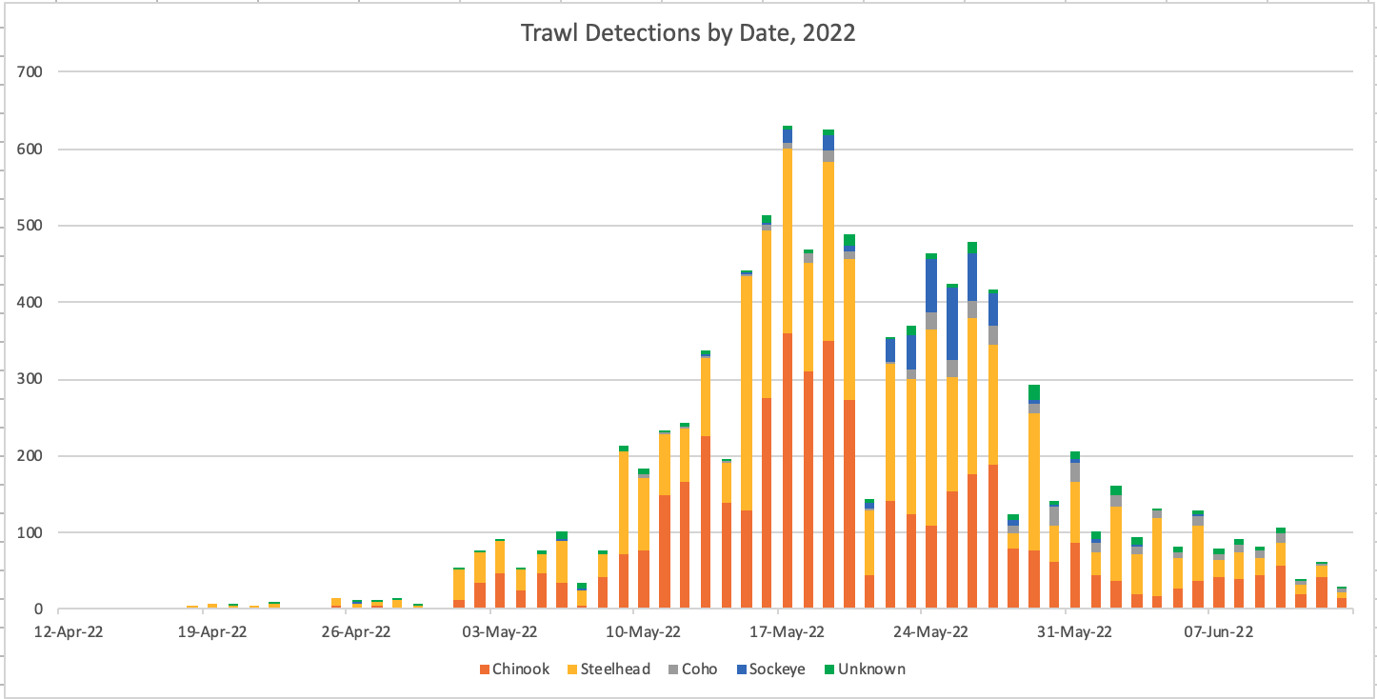
Trawl Detections 2022
Trawl detection for 2022 was 9838 unique detections

Slide 9
Total Releases and Trawl Detections 2000-2022
Migration Year | Total Releases (n) | Trawl Sample Dates | Trawl Detections (n) | Trawl Sample Hours | CPUE (fish/hour)
2000 | 1,265,606 | 18 Apr - 21 June | 5,940 | 553 | 10.7
2001 | 1,146,367 | 19 Apr - 22 June | 5,542 | 646 | 8.6
2002 | 1,823,402 | 15 Apr - 30 July | 11,451 | 693 | 16.5
2003 | 2,339,501 | 22 Apr - 30 June | 20,507 | 794 | 25.8
2004 | 2,026,981 | 14 Apr - 3 July | 16,492 | 872 | 18.9
2005 | 1,911,949 | 20 Apr - 5 Aug | 14,101 | 909 | 15.5
2006 | 1,998,166 | 9 Mar - 1 Nov | 12,361 | 961 | 12.9
2007 | 1,518,696 | 7 Mar - 19 July | 19,186 | 1,059 | 18.1
2008 | 2,478,982 | 17 Apr - 27 Oct | 16,563 | 1,035 | 16.0
2009 | 2,448,481 | 9 Mar - 12 Aug | 23,247 | 1,097 | 21.2
2010 | 2,861,892 | 23 Mar - 4 Aug | 31,327 | 902 | 34.7
2011 | 2,865,856 | 22 Mar - 1 July | 14,123 | 671 | 21.0
2012 | 2,934,172 | 14 Mar - 30 July | 16,732 | 951 | 17.6
2013 | 2,448,746 | 25 Mar - 25 July | 22,879 | 889 | 25.7
2014 | 2,275,928 | 18 Mar - 30 July | 15,904 | 925 | 17.2
2015 | 2,225,990 | 19 Mar - 2 July | 19,889 | 813 | 24.5
2016 | 2,184,653 | 24 Mar - 5 July | 12,165 | 829 | 14.7
2017 | 2,046,742 | 17 Mar - 16 June | 8,413 | 711 | 11.8
2018 | 2,057,875 | 26 Mar - 16 June | 9,990 | 695 | 14.4
2019 | 1,938,237 | 27 Mar - 15 June | 11,579 | 749 | 15.5
2021 | 1,529,981 | 2 Apr – 16 June | 5,112 | 487 | 10.5
2022 | 1,745,525 | 29 Mar – 13 June | 9,838 | 641 | 15.3
Mean detection across all years – 14,697 with an average of 2.1M tags.

Slide 10
Total Releases and Trawl Detections 2000-2022
Migration Year | Total Releases (n) | Trawl Sample Dates | Trawl Detections (n) | Trawl Sample Hours | CPUE (fish/hour)
2000 | 1,265,606 | 18 Apr - 21 June | 5,940 | 553 | 10.7
2001 | 1,146,367 | 19 Apr - 22 June | 5,542 | 646 | 8.6
2002 | 1,823,402 | 15 Apr - 30 July | 11,451 | 693 | 16.5
2003 | 2,339,501 | 22 Apr - 30 June | 20,507 | 794 | 25.8
2004 | 2,026,981 | 14 Apr - 3 July | 16,492 | 872 | 18.9
2005 | 1,911,949 | 20 Apr - 5 Aug | 14,101 | 909 | 15.5
2006 | 1,998,166 | 9 Mar - 1 Nov | 12,361 | 961 | 12.9
2007 | 1,518,696 | 7 Mar - 19 July | 19,186 | 1,059 | 18.1
2008 | 2,478,982 | 17 Apr - 27 Oct | 16,563 | 1,035 | 16.0
2009 | 2,448,481 | 9 Mar - 12 Aug | 23,247 | 1,097 | 21.2
2010 | 2,861,892 | 23 Mar - 4 Aug | 31,327 | 902 | 34.7
2011 | 2,865,856 | 22 Mar - 1 July | 14,123 | 671 | 21.0
2012 | 2,934,172 | 14 Mar - 30 July | 16,732 | 951 | 17.6
2013 | 2,448,746 | 25 Mar - 25 July | 22,879 | 889 | 25.7
2014 | 2,275,928 | 18 Mar - 30 July | 15,904 | 925 | 17.2
2015 | 2,225,990 | 19 Mar - 2 July | 19,889 | 813 | 24.5
2016 | 2,184,653 | 24 Mar - 5 July | 12,165 | 829 | 14.7
2017 | 2,046,742 | 17 Mar - 16 June | 8,413 | 711 | 11.8
2018 | 2,057,875 | 26 Mar - 16 June | 9,990 | 695 | 14.4
2019 | 1,938,237 | 27 Mar - 15 June | 11,579 | 749 | 15.5
2021 | 1,529,981 | 2 Apr – 16 June | 5,112 | 487 | 10.5
2022 | 1,745,525 | 29 Mar – 13 June | 9,838 | 641 | 15.3

Slide 11
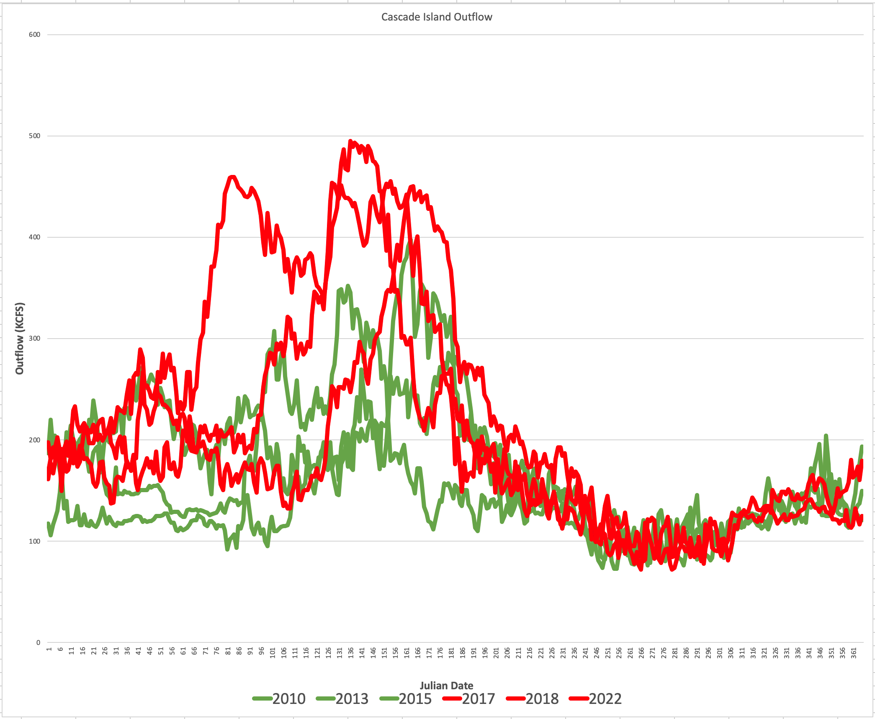

Slide 12
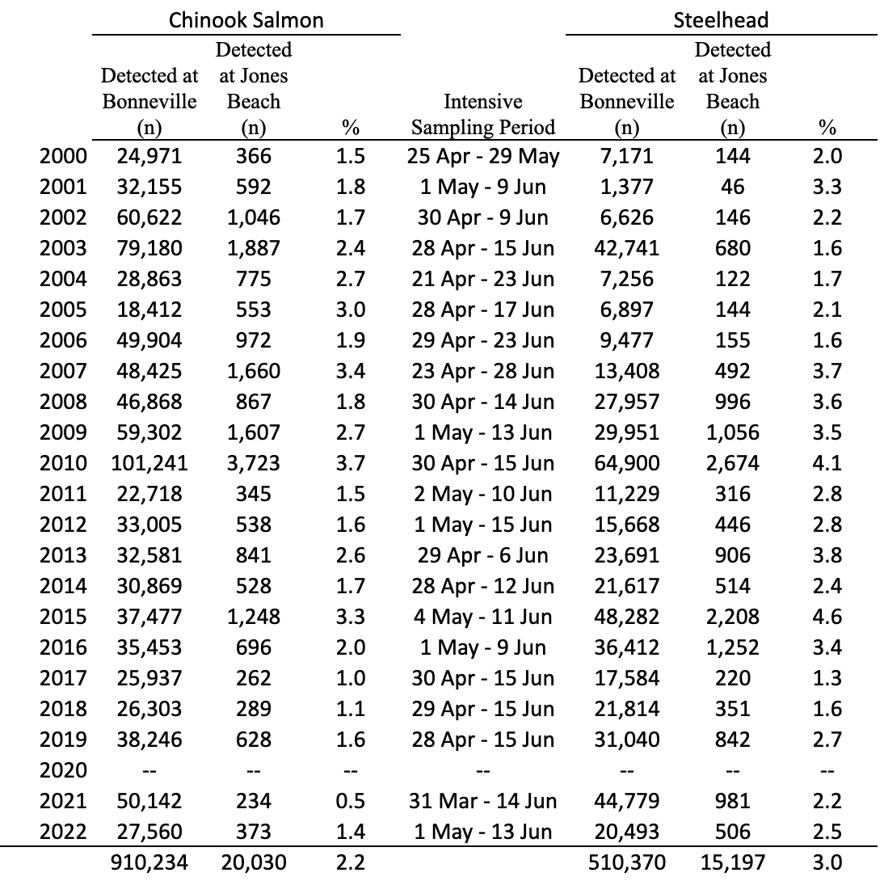
Trawl Detection Rates 2000-2022
Trawl detection rates in the Columbia River estuary (rkm 75) for fish previously detected at Bonneville Dam (rkm 234) during intensive sampling periods, 2000-2022.

Slide 13
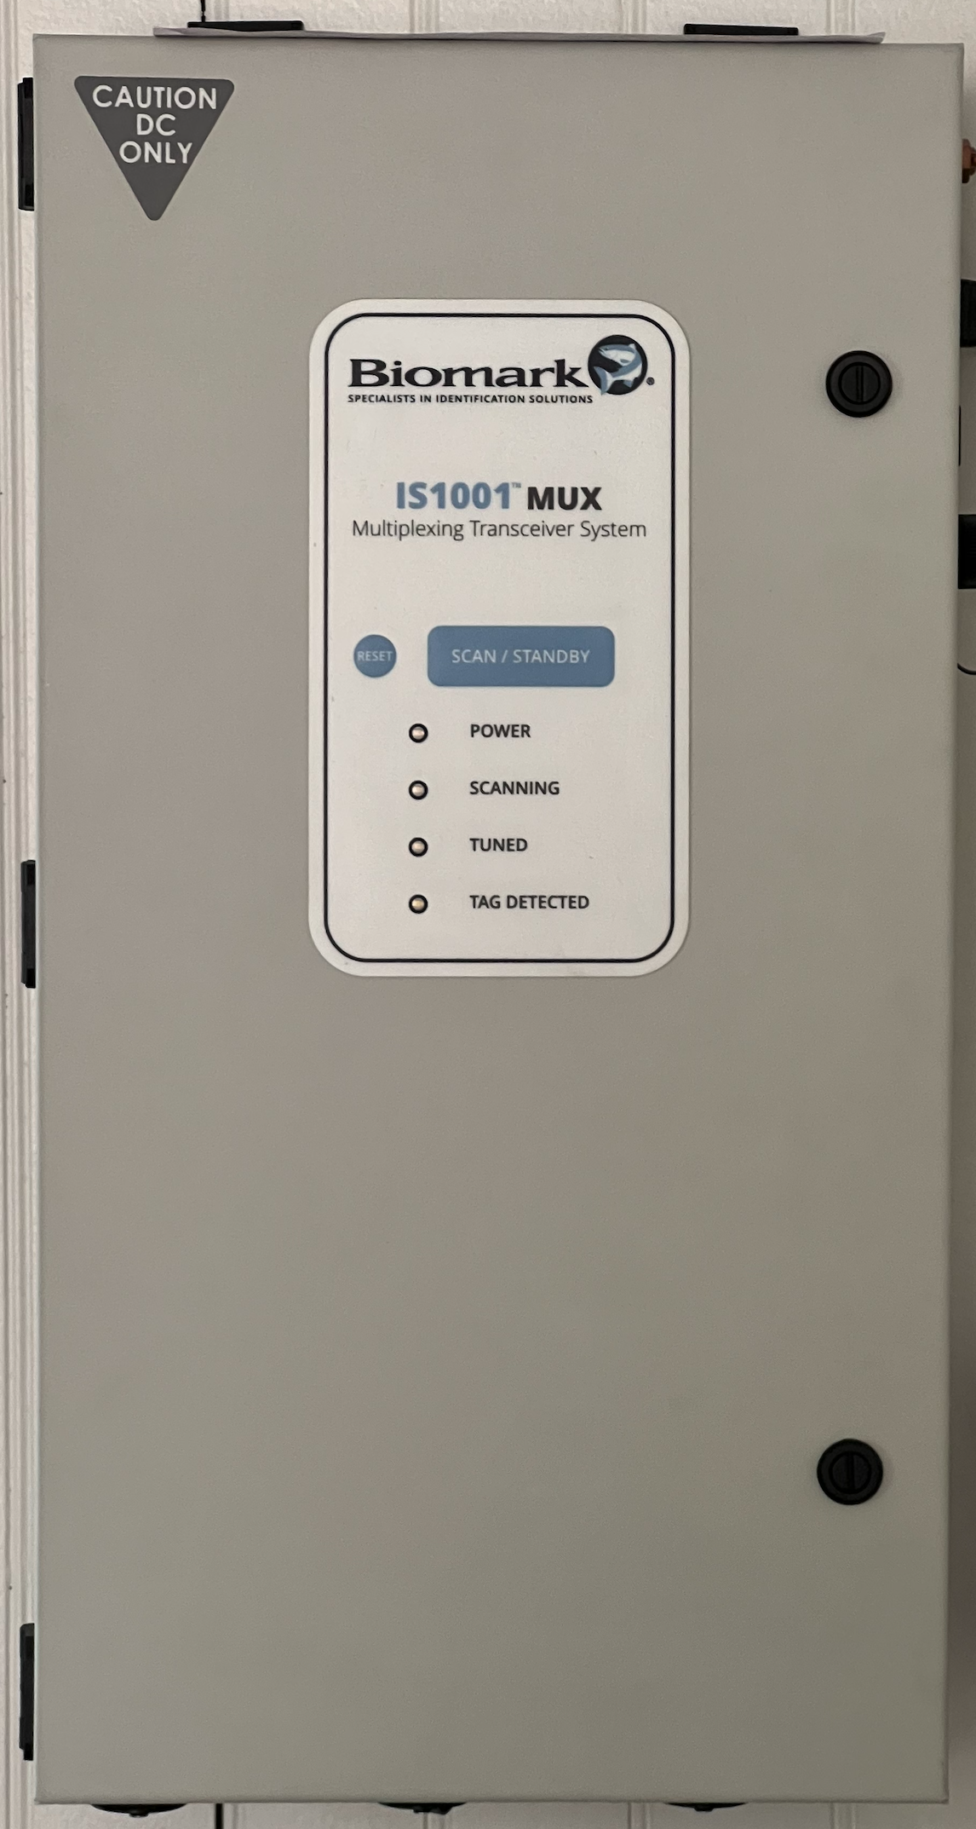
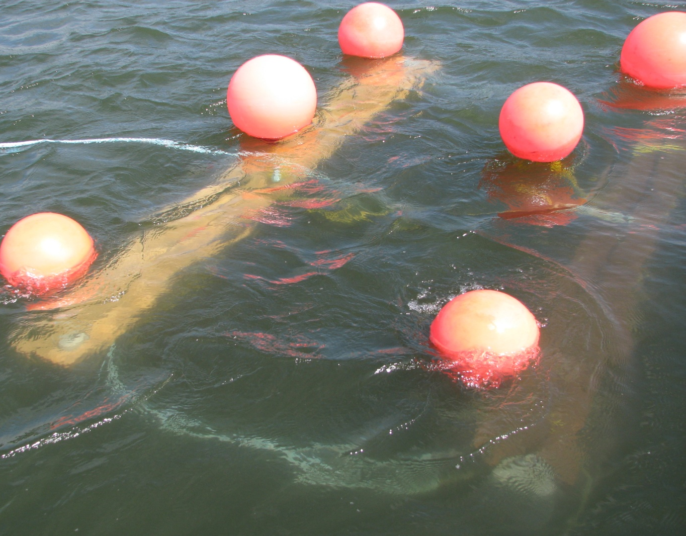
Trawl Improvements - 2023
Antenna arrays were replaced in 2021 but tuned to utilized the deprecated FS1001-M
Replace the FS1001-M with the newly developed IS1001-MUX, modifying the antennas to accept either unit allowing us to revert if needed

Slide 14
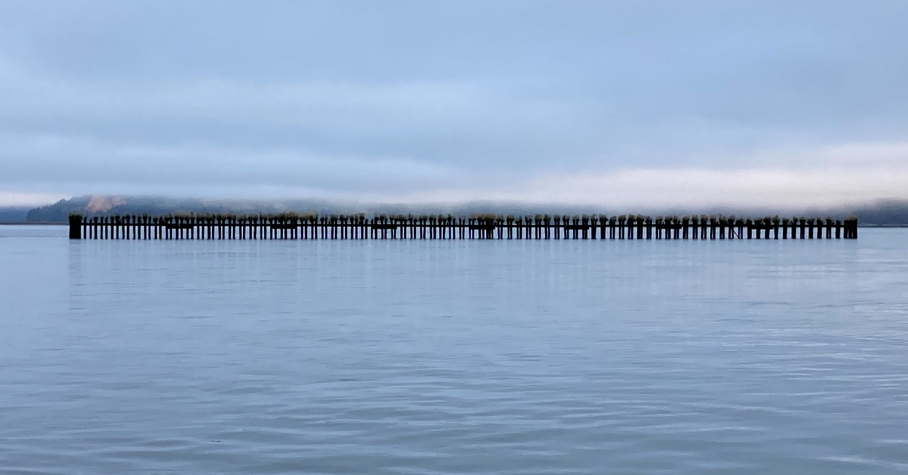
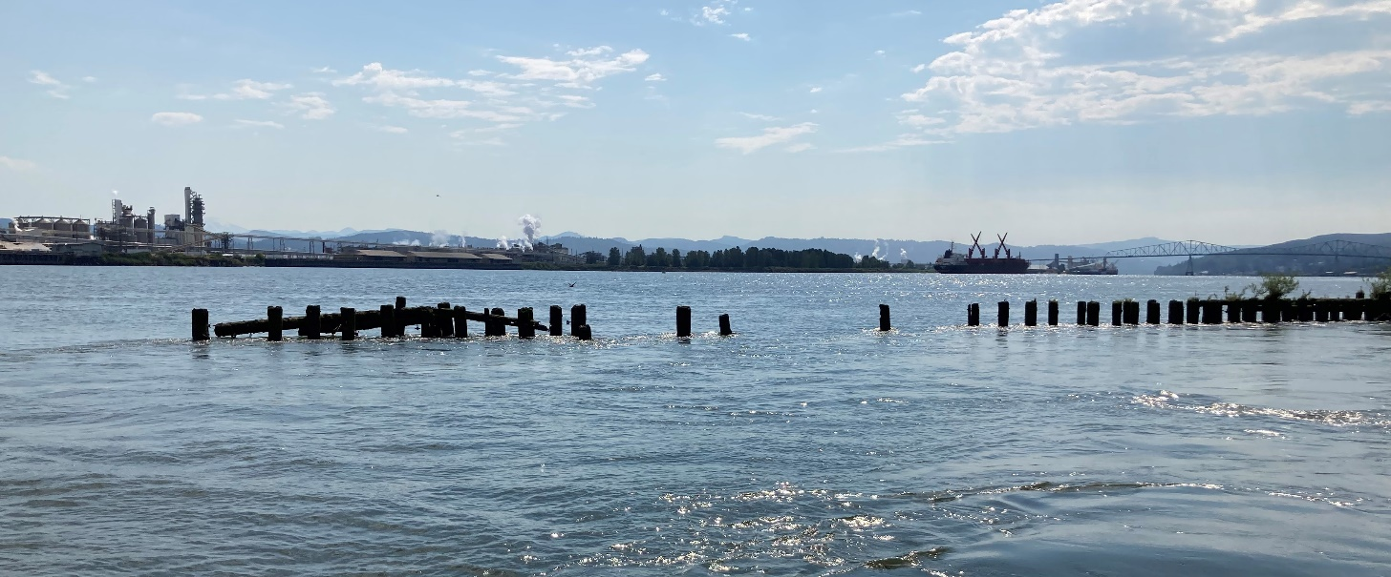
Pile Dikes
RM 22.75
RM 63.62

Slide 15
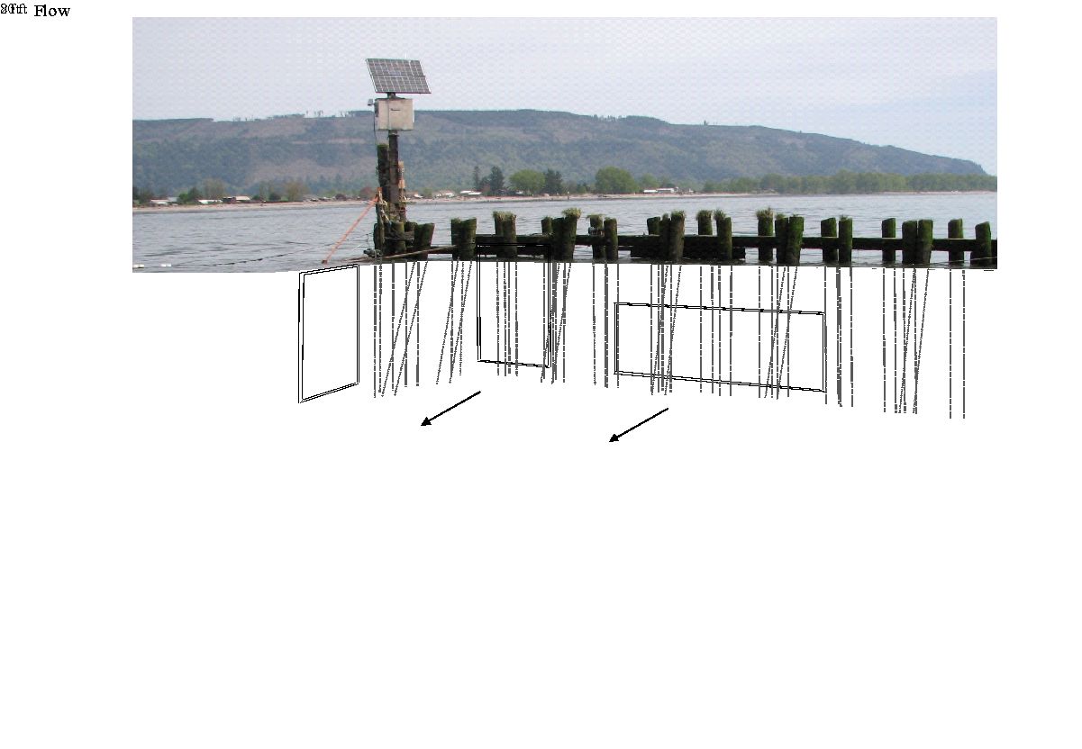
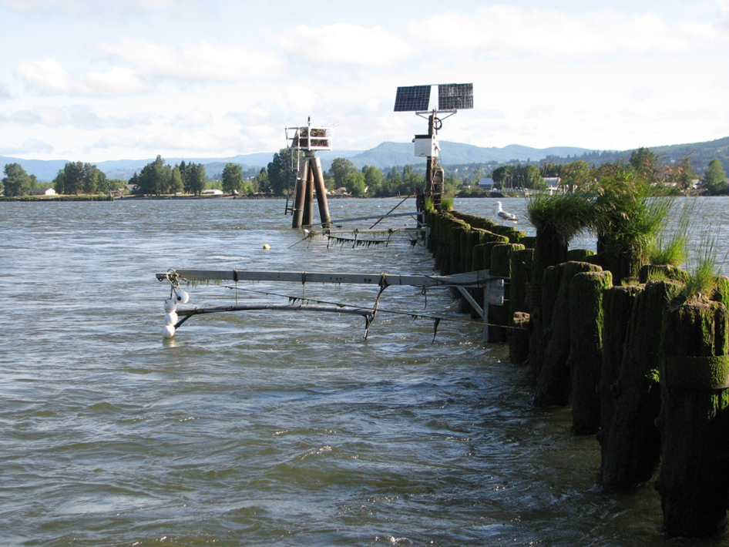
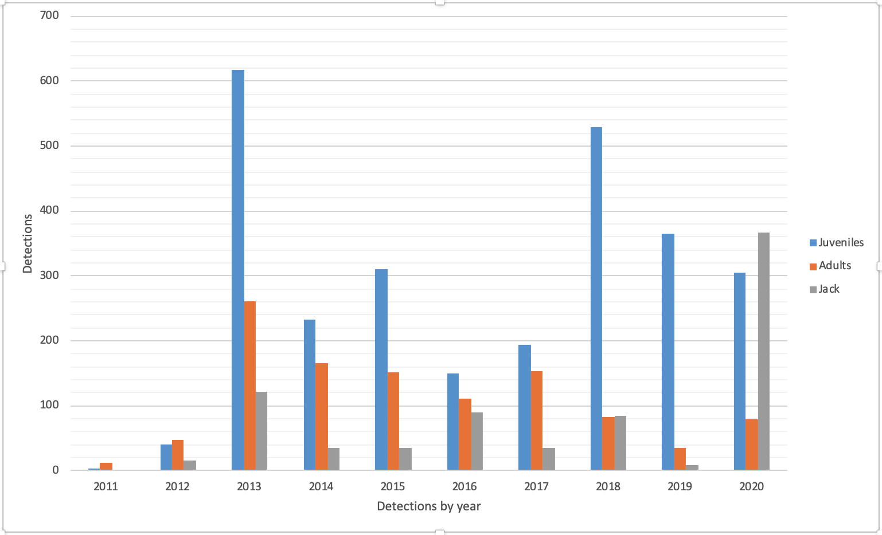
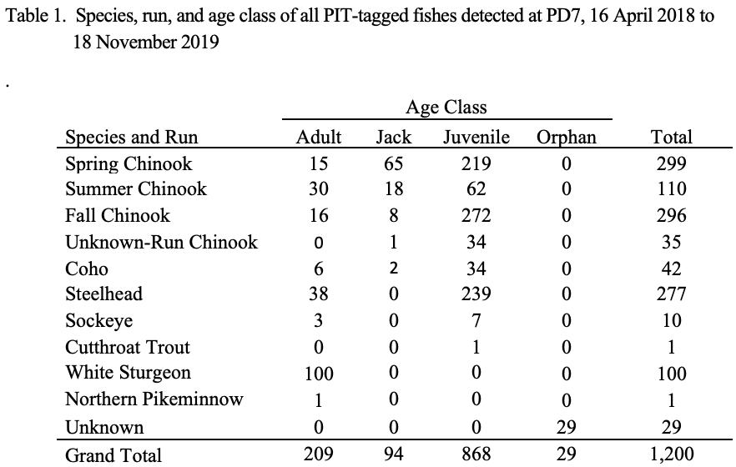
PD7
Flow

Slide 16
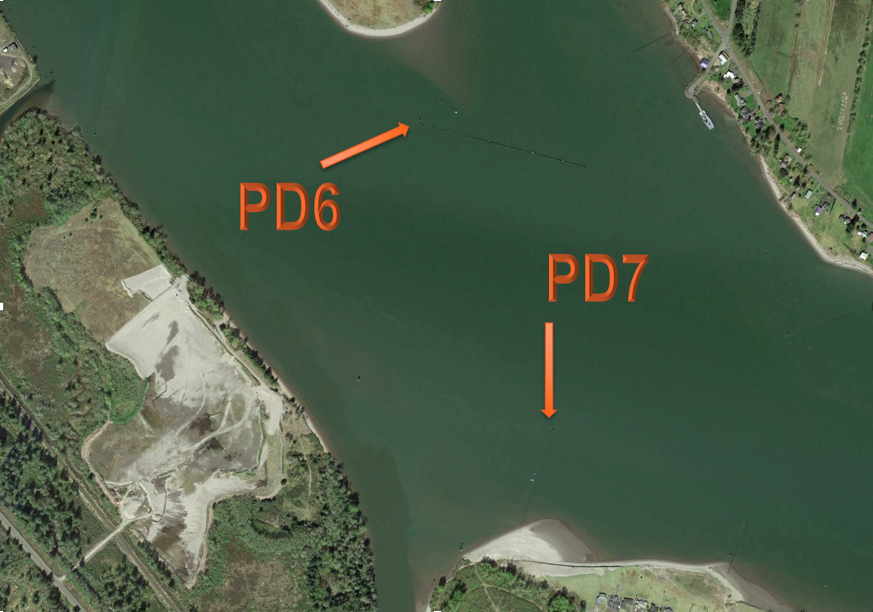
PD6

Slide 17
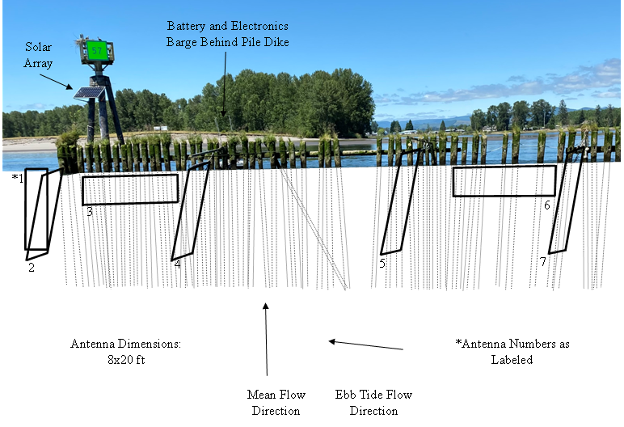
PD6 Antenna Orientation, 2022

Slide 18
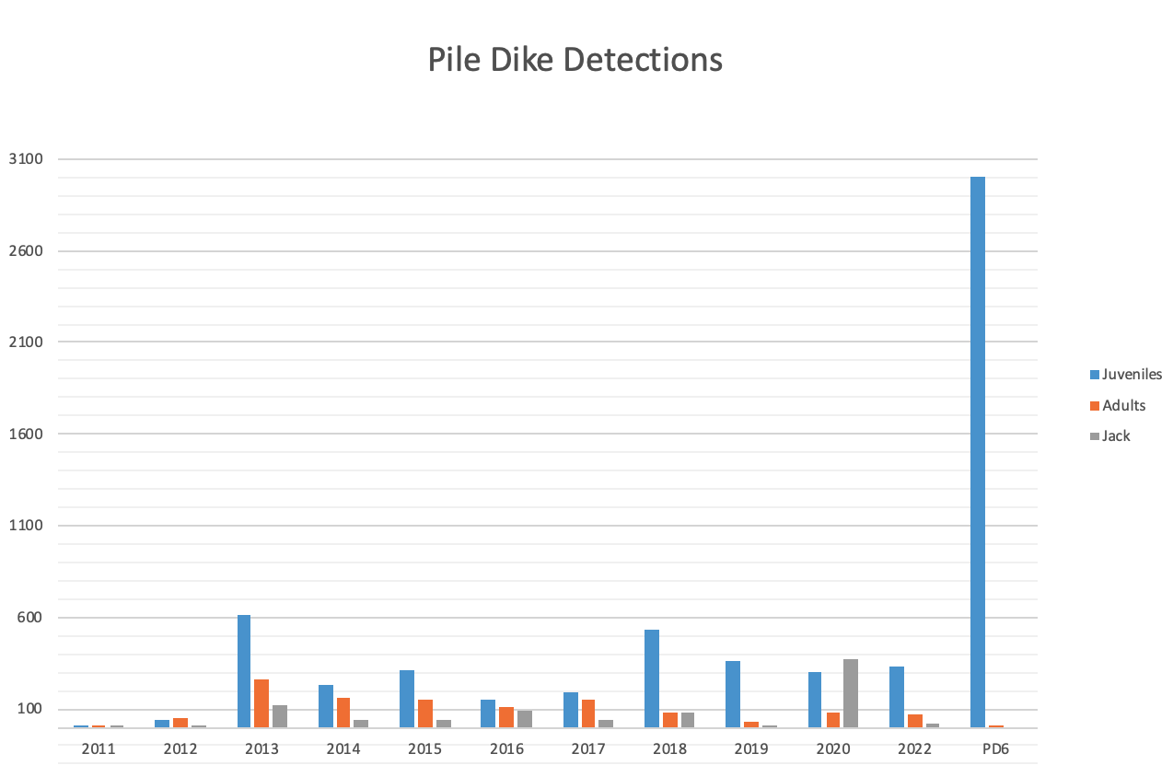
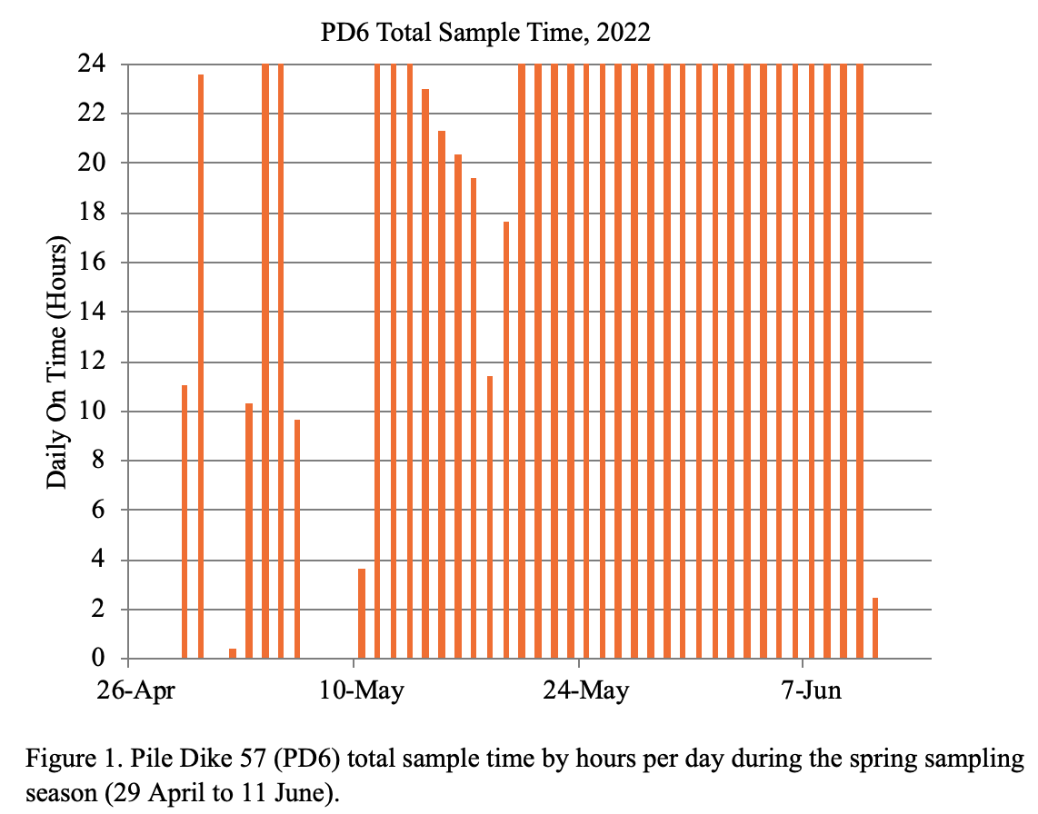
PD6 detections and up-time

Slide 19
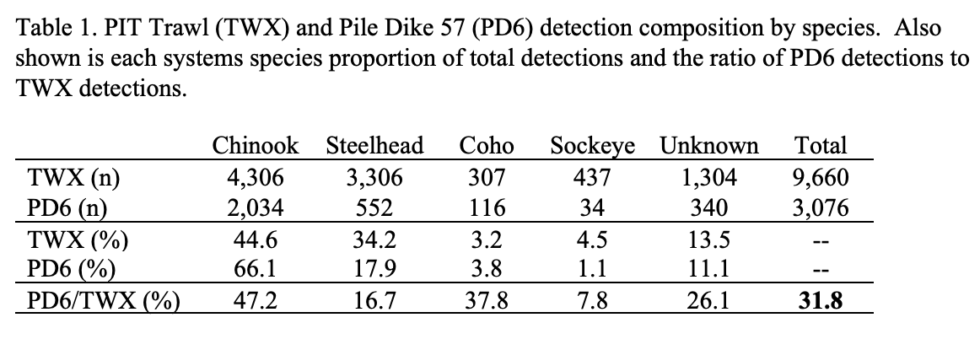
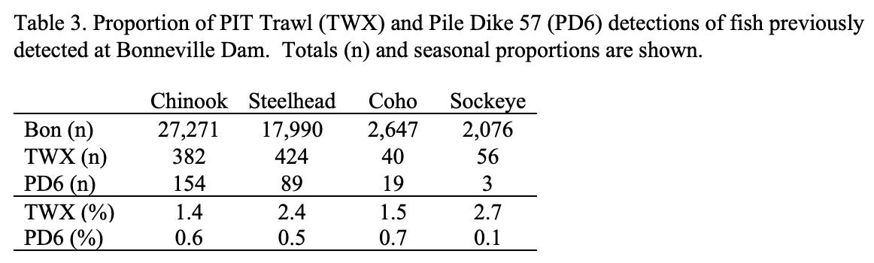
PD6

Slide 20
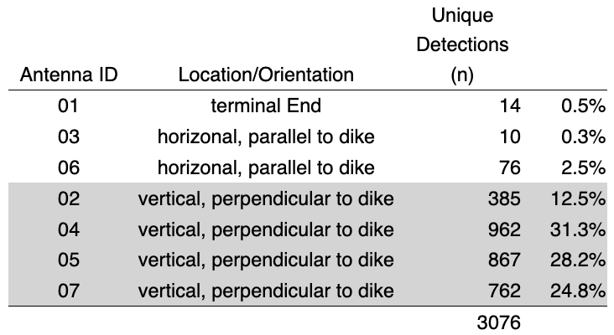
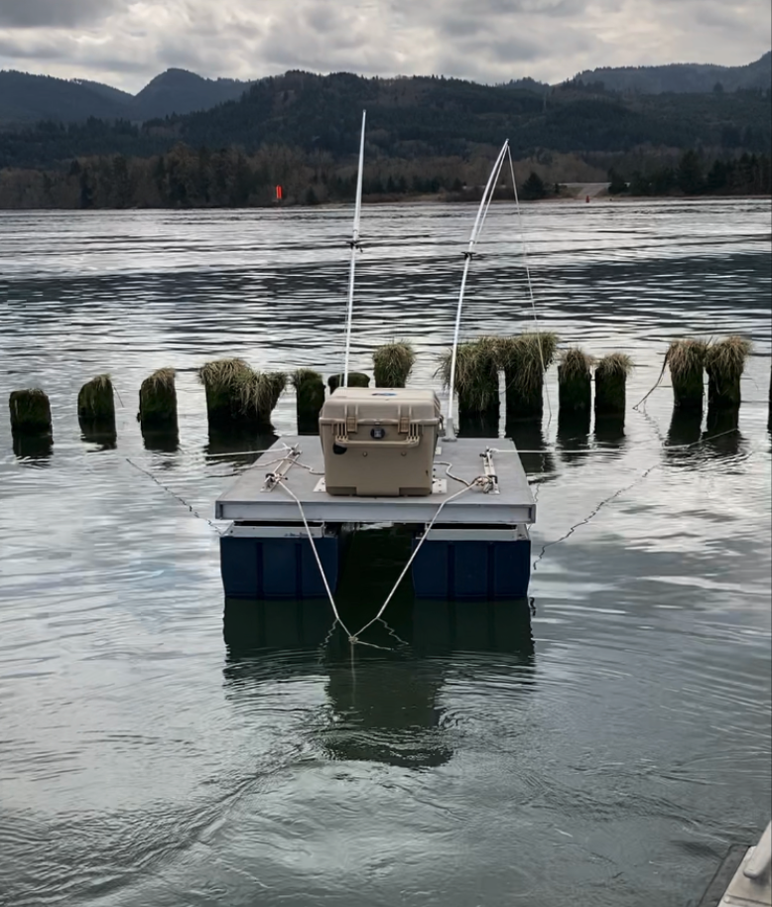
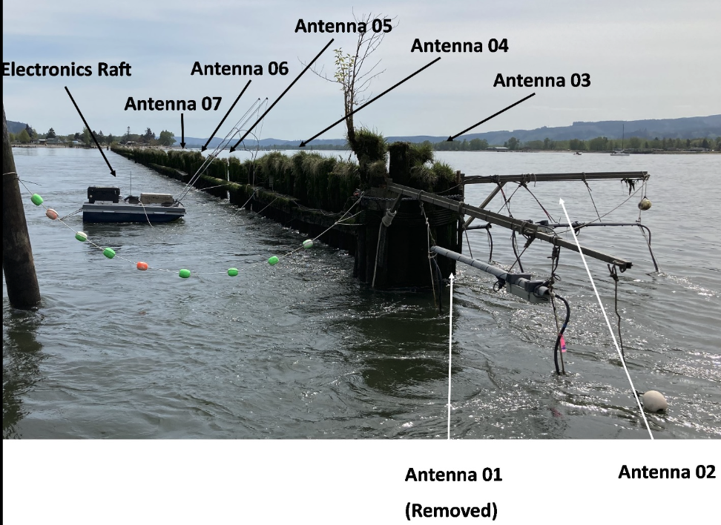
PD6 Antenna Orientation, 2022

Slide 21
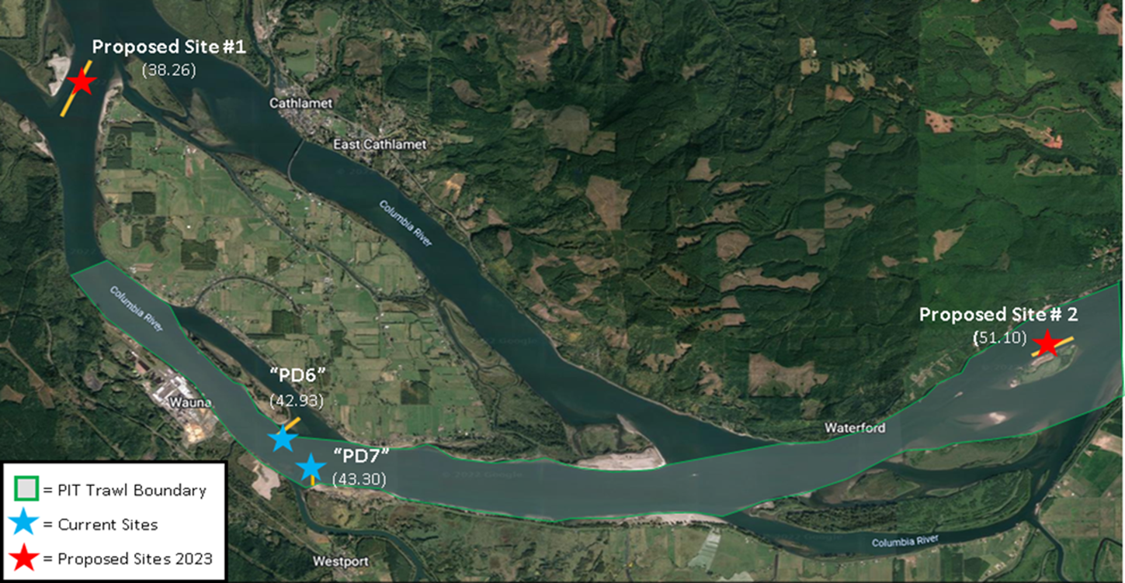
Proposed Pile Dike sites in 2023

Slide 22
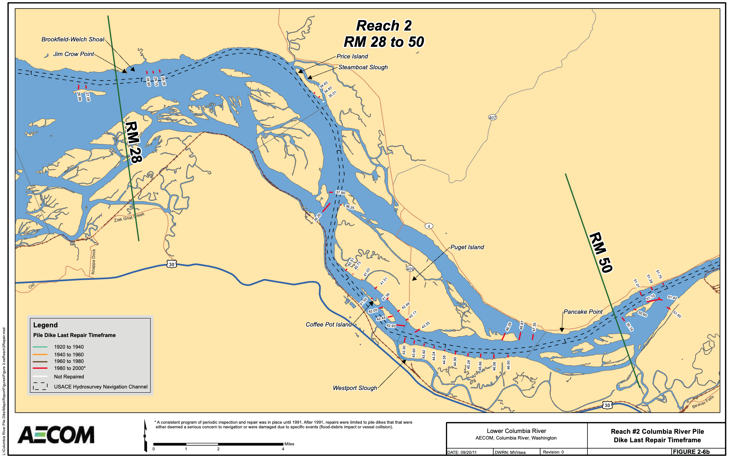
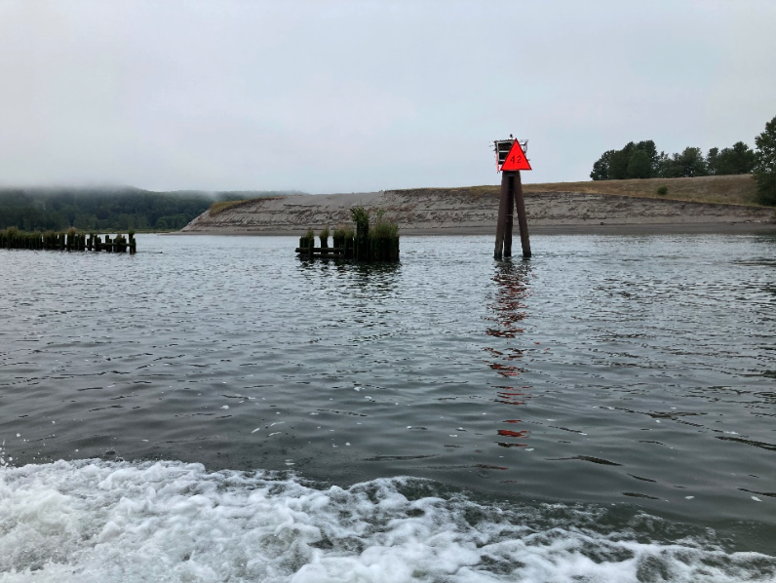
PD5 (To be installed)

Slide 23
Future Pile Dike Antenna Arrays
Planned expansion to 3 sites in 2023 (PD5, PD6, PD7)
Exploring pile dikes of different orientations to flow
Observe for bias
New site “PD6” installed in 2022
Detected ~33% of PIT Trawl detections
3:1 detection ratio of Chinook:steelhead
Increase Site resiliency
Electronics are prone to damage from high flows and debris loads
Currently evaluating HDPE antennas to better withstand high flows and debris loading
New electronics barge design
System no longer requires a large king pile
New solar charge controllers and DC-DC converters improve power efficiency, reducing costs

Slide 24
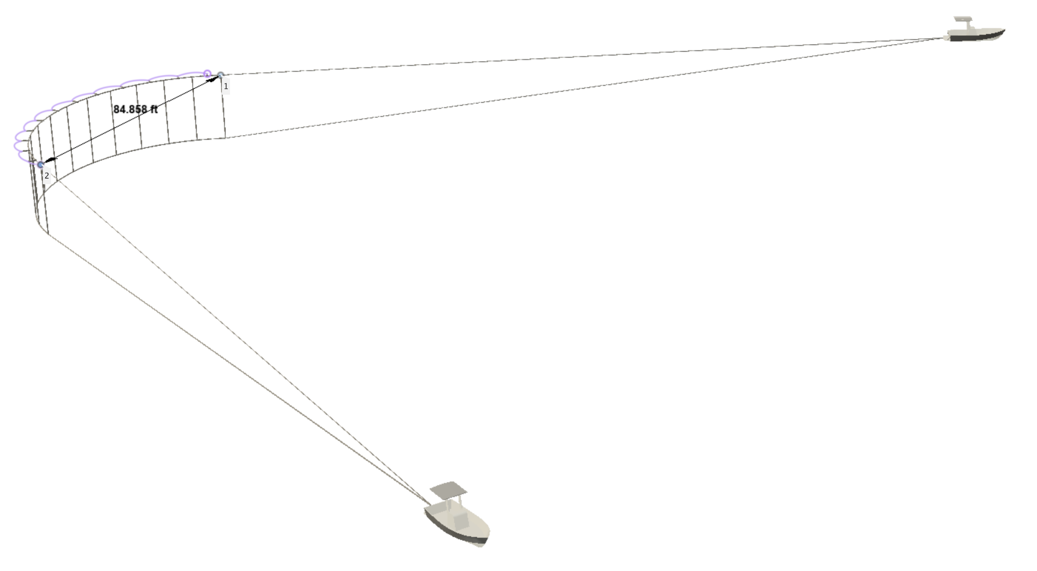
Flexible Array
Will operate in tandem with PIT Trawl and pile dike sites in 2023
Six 8x20’ antennas connected horizontally in series
Daylight sampling 5 days per week to maximize juvenile steelhead detections
During 10 day tandem sampling, in 2016, a 6 antenna array detected 103% of TWX steelhead detections
6:1 detection ratio of steelhead:Chinook
Simplify deployment and retrieval methods
Reduce the risk of entanglement, personnel injury, and improper array orientation
Currently testing deployment/retrieval from a net reel
New capsules
Designed specifically for the Towed Array
Better cable strain relief at attachment points
Allows for the use of net reel for ease deployment/retrieval
Scalable
Unlike the TWX system, the FACA can be easily scaled

Slide 25
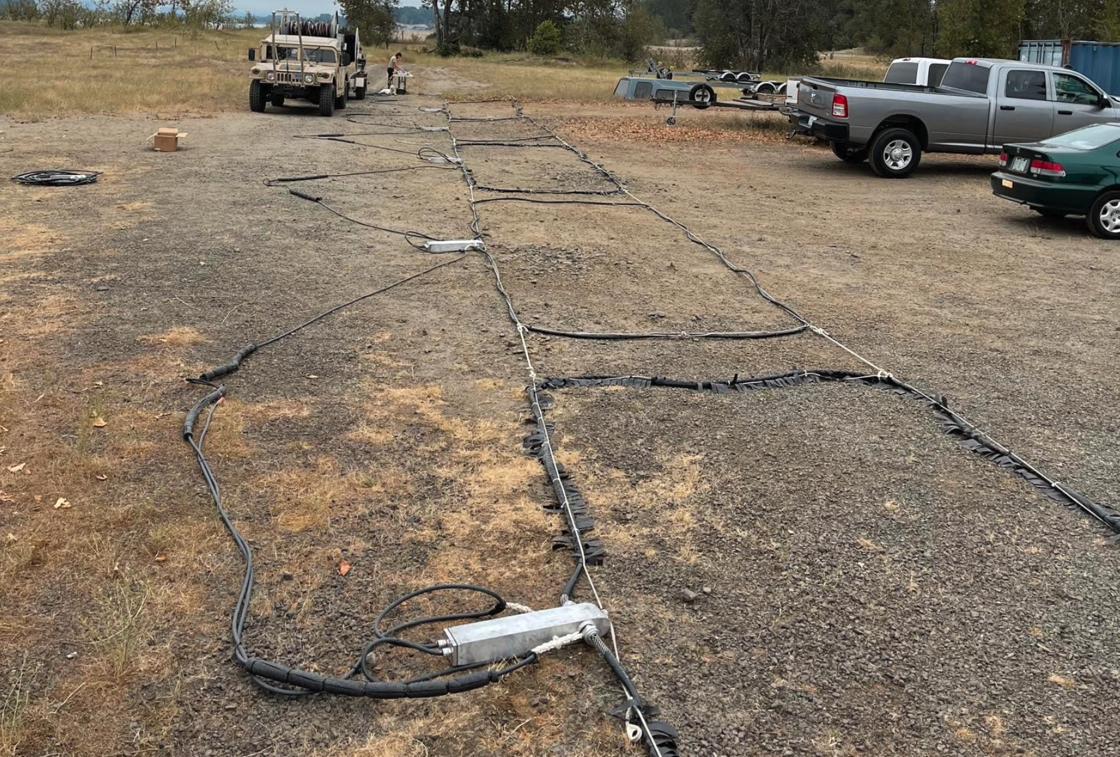
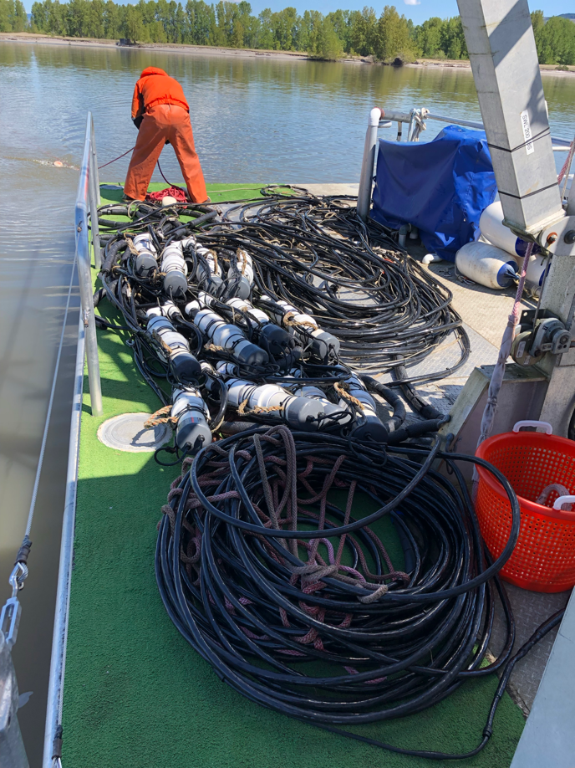
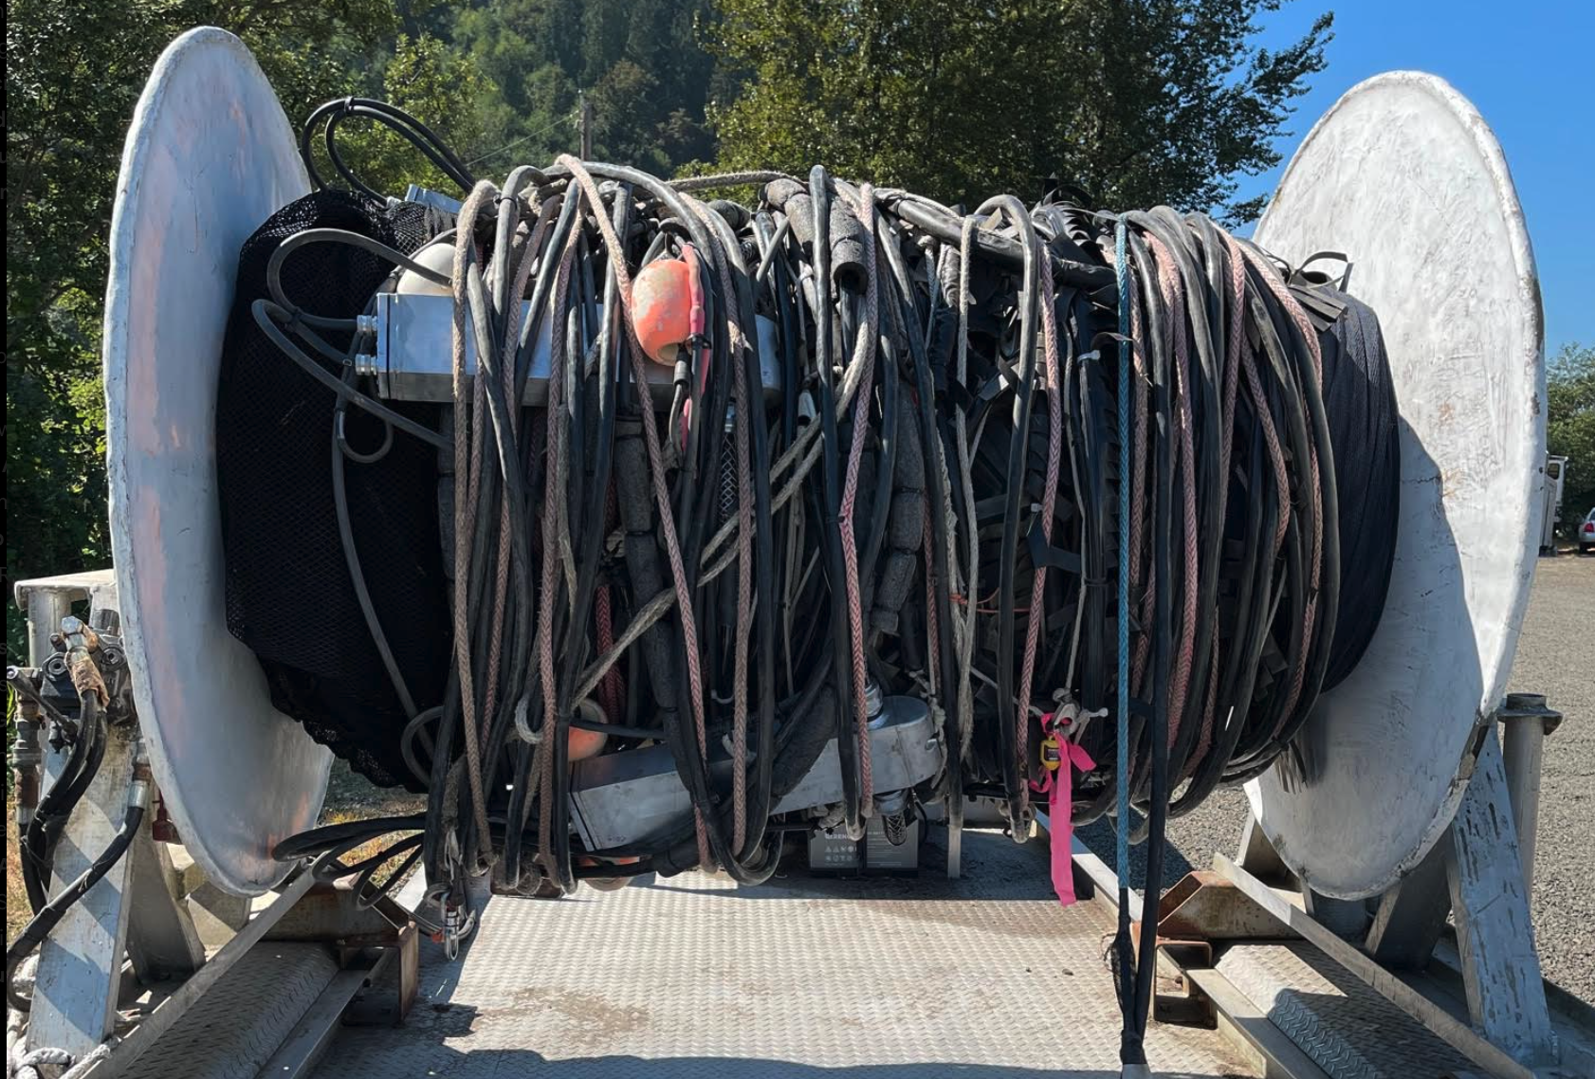
Flexible Array

Slide 26
Proposed Sampling 2023 and 2024
Direct comparison between PIT Trawl and a combination of pile dike arrays and towed flexible system.
Operate at least 3 pile dike sites
Sample PIT Trawl as normal (24/7)
Sample towed flexible system 5 days/wk during daylight hours to maximize steelhead detections
Assess outcomes from 2023 and 2024 to determine best method(s) to achieve future detection goals of 3-5%
Adapt accordingly – try other systems and locations

Slide 27
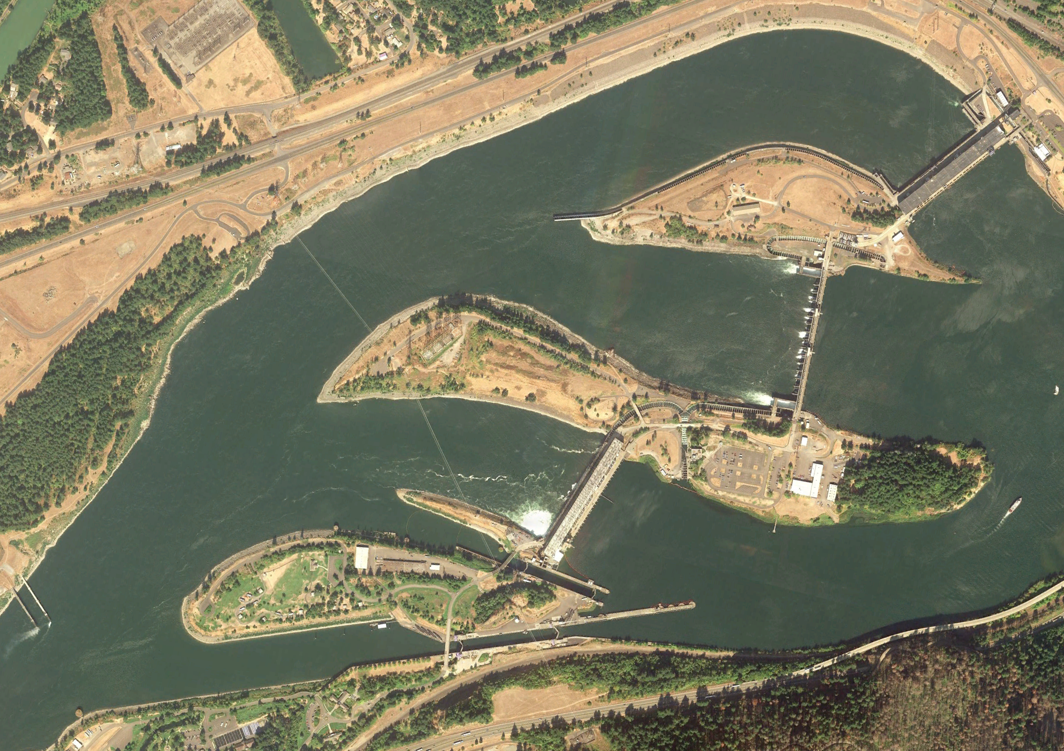
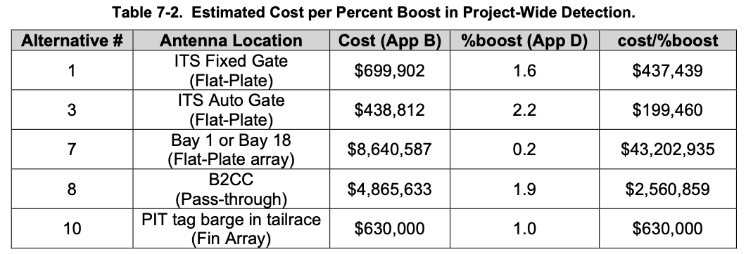
Bonneville PIT
Ten locations were evaluated in 2019 EDR “Juvenile PIT Tag Detection Prototype for Precision Increase”
ITS fully wired at $1.14M* with an estimated 3.8% increase
* - 2019 dollars

Slide 28
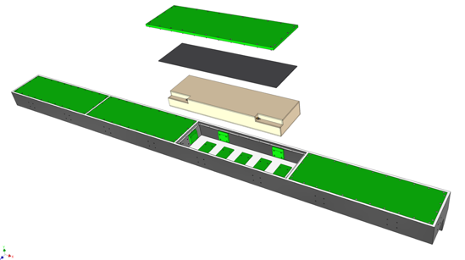
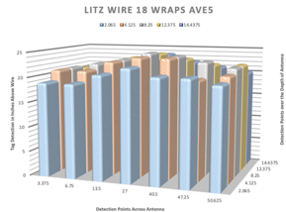
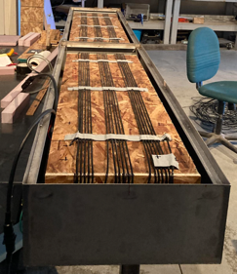
Bonneville I&TS
PSMFC/NOAA design, based on GRS antennas and stainless steel structural housing as antenna shield
Prototype antenna and wet and dry testing completed
ACOE needs to review the PSMFC design drawings

Slide 29
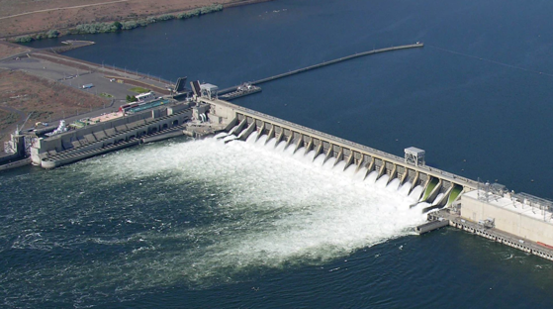
McNary
NOAA estimates in 2021 nearly 500k tagged fish pass MCN undetected, mostly through spillways
2021 MCJ detected 25,632

Slide 30
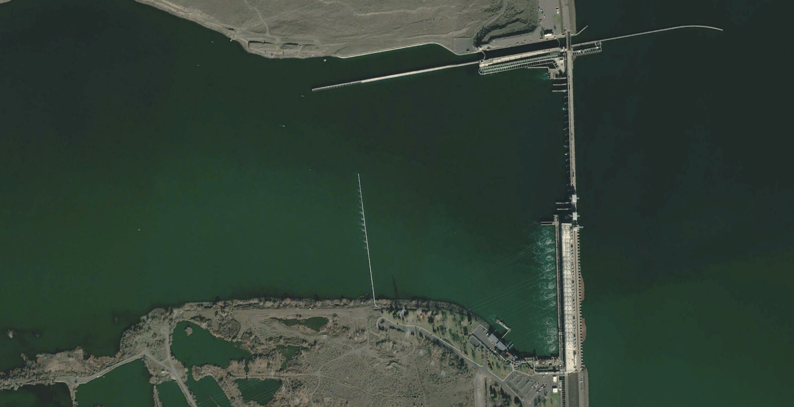
McNary
Options for increasing detections at MCN include:
PIT barge in forebay or tailrace
FACA style system could be operated in forebay or tailrace
FIN antennas on MCJ outfall structure
Spillway detection

Slide 31
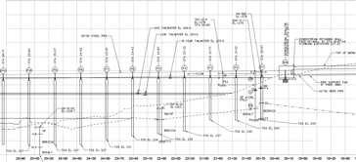
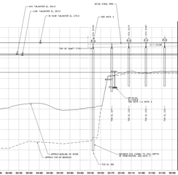
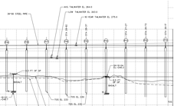
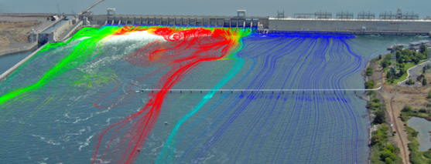
McNary
Year-round detection possible
Manageable depths across the entire structure
IIHR-Hydroscience & Engineering, University of Iowa
24 – 48” concrete pilings with 50’ spacing extending 1200’ into the river
Option to target certain passage routes based on previous hydraulic and active tag studies

Slide 32
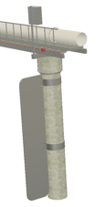
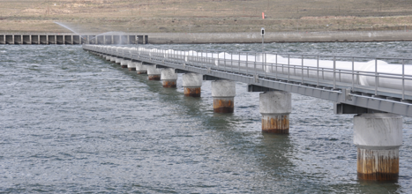




McNary
FS3001 with remote control ~ 60” single side RR
IS1001 as a low cost option ~ 30” single side RR
Placed in areas recognized as likely routes for fish passage from locations of interest (i.e. turbines, TSW, etc.)
Estimated cost ~$3.3m to get back to 15% detection rate

Slide 33



McNary
Read range of 60” could capture approximately 25% of the water column at elev. 340
Estimated cost ~ $1.33m
Read range of 60” could capture approximately 20% of the water with one fin antenna
Estimated cost ~ $800k
Read range of 60” could capture approximately 30% of the water with two antennas
Estimated cost ~ $900k

Slide 34
Summary
Vision of future improvements
Near-Term (three years)
Additional Pile Dike sites and FACA concurrently with the TWX to establish detection rates and potential for bias and implement improvements
Bonneville ITS system to prove SS shield approach
Long-Term(>three years)
MCN spillway or near-project improvements to bolster MCN detection rate
Additional pile dike sites as needed to reach 5% redetection target

Slide 35

Questions?
Photo by Dr. Jonathon Armstrong

